Slide 1

STUDENT ALCOHOL CONSUMPTION
Supervisor- Savita Seharawat
Presenter – Komal Arora (0763537)

Slide 2



Descriptive Analysis
INTRODUCTION
Education is the key to success, and success is usually measured in terms of student academic performance. But today, many students are addicted to alcohol, which affects their grades. So, basically in this project we are finding the key factors that affect the grade of students.
Dataset contains 33 columns about students which explains data about their grades, performance, how often they are using internet, their attendance record and family background like their parents are living together or apart and other factors related to their personal life
The numerical variables are – age, absences, G1, G2, G3
The categorical variables are – school, sex, address, famsize, Pstatus, Medu, Fedu, Mjob, Fjob, reason, guardian, traveltime, studytime, failures, schoolsup, famsup, paid, activities, nursery, higher, internet, romantic, famrel, freetime, goout, health, alc.

Slide 3

Objective
The reason behind using this data set is finding the reason behind the consumption of alcohol among youth because in this present era students become addict of narcotic substance easily, because of the surrounding, modernization and the company of their friends. Our focus is to focus over the effect on the performance of students due to alcohol in grades the course subject, Math. Using the attributes and performing the functions and other codes help us to find out the consumption of alcohol made by students.
While performing on the datasets and finding the solutions to some questions.
Does alcohol effect success i.e., Grades and what factors contribute in that?
Which gender, age group consume more alcohol?
Which school has better at grade performance among both schools?

Slide 4
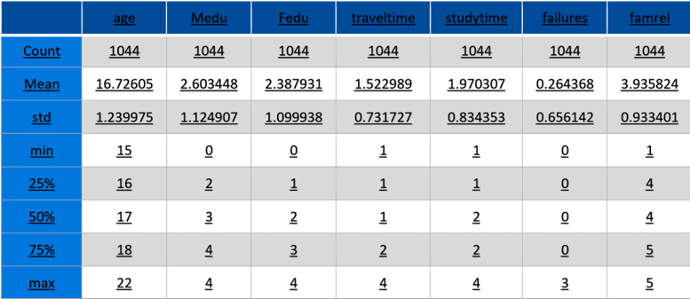
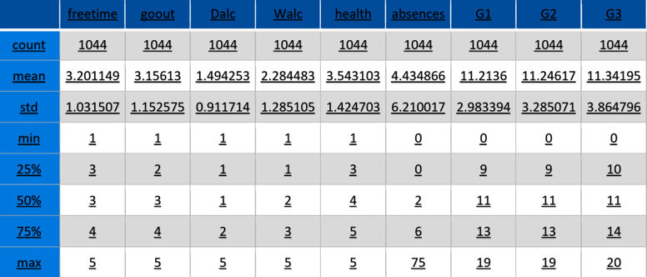
Descriptive Analysis
Descriptive Analysis
It describe the characteristics of a data set. The tables shows basics statistics of each feature such as count , average ,standard, deviation ,minimum value, maximum value and all three quartile for all necessary attribute

Slide 5
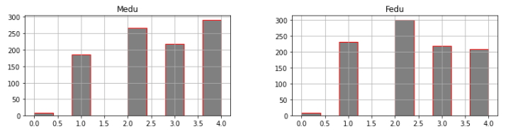

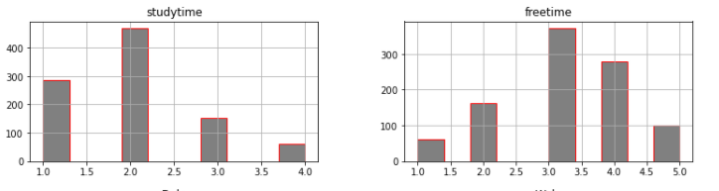
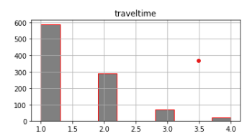
Categorical Variables
The variable has two or more categories. For example ,a binary variable(0,1) is a categorical having two categories (1/0). But in my dataset, I have more than two categories for the categorical attribute.
For mother and father education it has 4 levels (0- none 4th grade), 2 – 5th to 9th grade, 3 – secondary education or 4 – higher education) The mother education histogram given above represent the axis, Where X axis shows the level of education, where Y axis shows the count, where majority of mothers lies within level 4 with the higher education.
The correspond graph against the mother education represent the father education where axis represent basically the level of father’s education but in this graph majority of father edu lies between level 2- 2.5.
This Graph Elucidates home to school travel time ( 1 - <15 min., 2 - 15 to 30 min., 3 - 30 min to 1 hour, or 4 - >1 hour) Travel time histogram represent the time taken to travel to school i.e 15mint to 1 hours which is represented in levels of 1,2,3,4 in the data set , where more than 600 students travel 15 mints to come to school and not more than 50 students take 1 hour to reach school.
Weekly study time (1 - <2 hours, 2 - 2 to 5 hours, 3 - 5 to 10 hours, or 4 - >10 hours) According to study time histogram representation most of the student’s study for 2 to 5 hours and very less no. of student’s study for more than 10 hours.

Slide 6

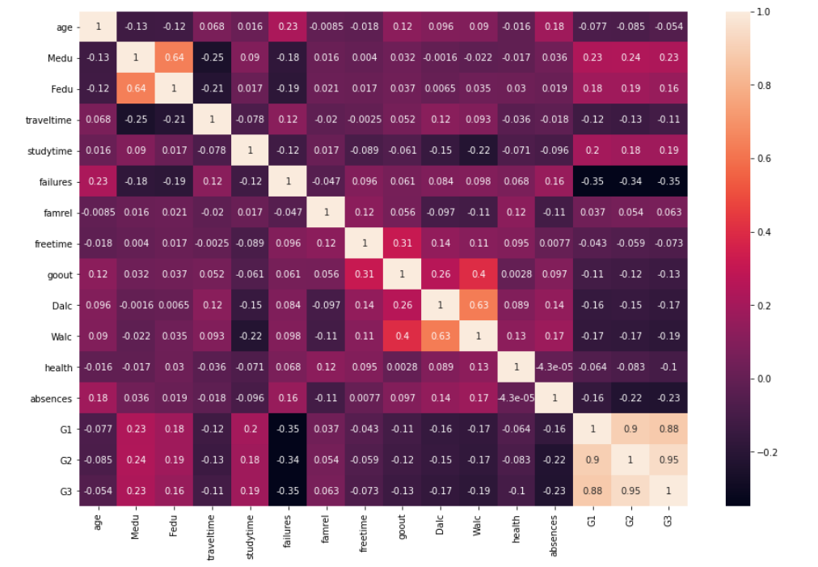
Correlation matrix
It is a measure of the strength of a linear relationship between two quantitative variables. When two variables are highly correlated that means they have similarity in their nature . Its value lies between(-1 to 1) Two variable are said to highly correlated when its heatmap we can se G1 and G2 are highly correlated because their value is 0.9

Slide 7

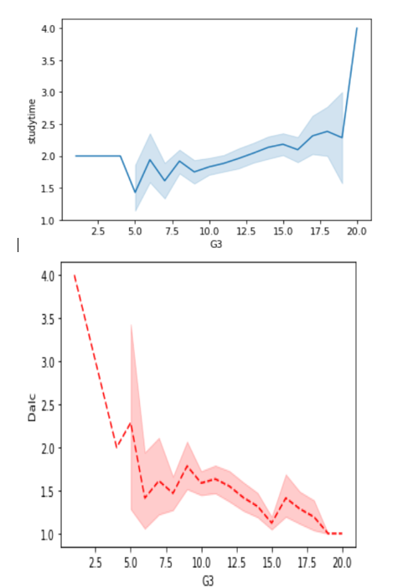
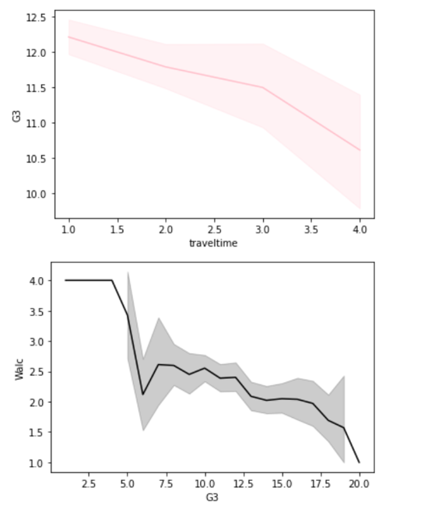
Factor Affecting Final grades
G3 are the final grades of students. From all these line charts it is transparent that G3 is affected by the time given by the students for study and traveling time.
In First plot it is clear that as the level of alcohol increase grade of the students goes down . Whereas in the second plot, as the student gave more time to their studies their grades increase automatically

Slide 8
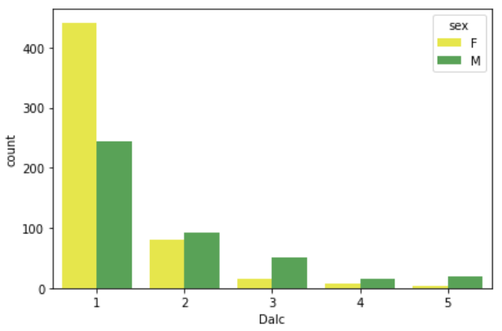
Which Gender Consume More Alcohol
This graph represents the information about consumption of alcohol by male or female. In ordinary words who drink more alcohol on weekdays. Between the levels from(1 is low -5 is high ) . It can be seen that more number of female are consuming low level of alcohol than male.

Slide 9
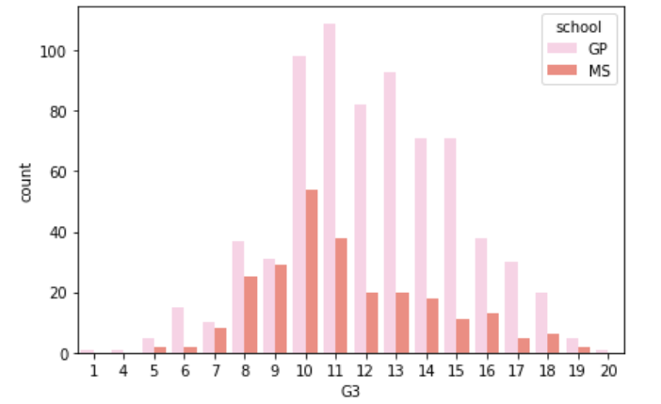
Which School Has Better At Grade Performance
The below graph represents the information about which school students have more grade 3. In our dataset we have two schools- GP and MS. We can clearly see that GP students achieved more grade3 as compared to MS students.

Slide 10
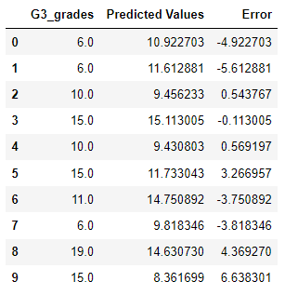
Descriptive Analysis
Linear Model
In statistics, it is a linear approach for modelling the relationship between a dependent and independent variables. It also explain the relationship between variables by drawing a line called as predicted line and it use a straight line.
G3 is considered as a target variable in this linear model which is the final grades among all the grades whereas G1,G2 and Age are independents variables. After that, finding the coefficients of independents variables. We also check the accuracy of model.

Slide 11
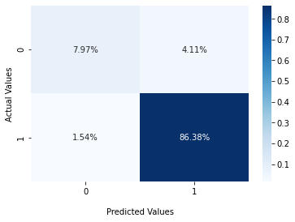
Descriptive Analysis
Logistic Regression
Confusion Matrix
It is a classification algorithm. It is used to predict a binary outcome . It works same like linear regression but when we have attributes with two outcomes only the we use logistic regression. Moreover, it is used to find likelihood of “yes” or “no” outcomes/”0” or “1”. By finding such results logistic regression helps data analyst to take decisions for their companies..
This is the confusion matrix corresponding to logistic regression. In this it is clear that 4.11% it 1 but the actual value is 0 and 1.54% it predict 0 but actual value is 1.
Accuracy of model | 0.9484536082474226

Slide 12
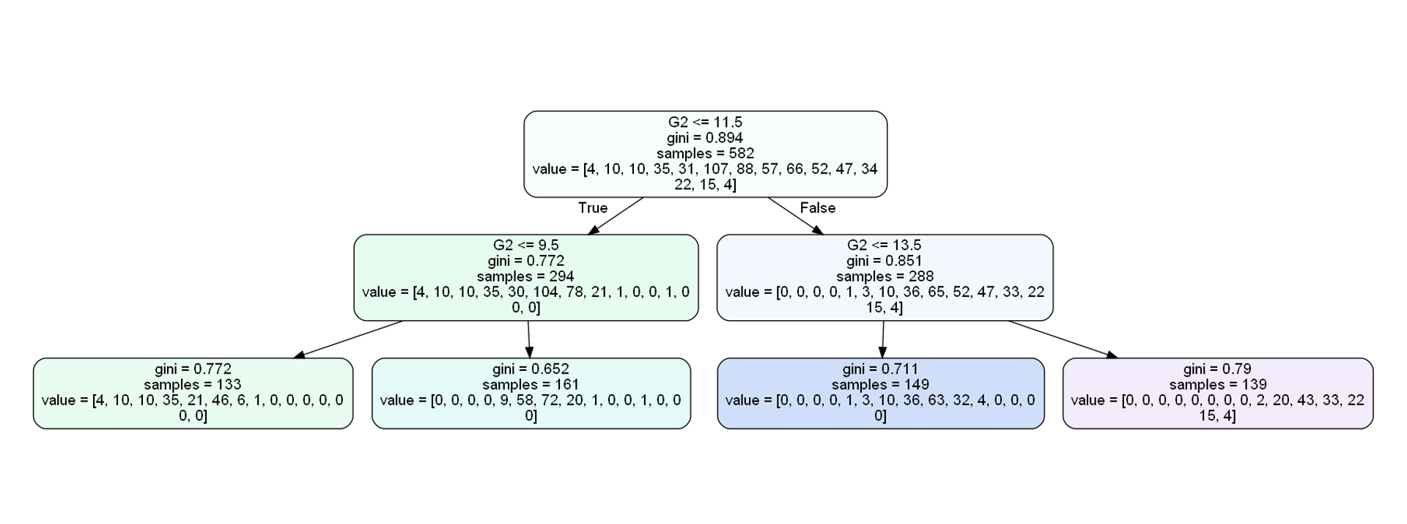
Decision Tree
A decision tree is a type of flow chart that depicts the decision-making process by laying out many options and their potential outcomes. (The top-level node displays the final goal or major decision you're attempting to make.) Node of the leaf The leaf nodes, which are attached at the ends of the branches, represent the likely outcomes of each action.

Slide 13
Random Forest
A random forest is a meta estimator that employs averaging to increase predicted accuracy and control over-fitting by fitting a number of decision tree classifiers on various sub-samples of the dataset. If bootstrap=True (default), the sub-sample size is regulated by the max samples argument; otherwise, the entire dataset is utilised to create each tree.
Accuracy | 0.8772058821089458

Slide 14
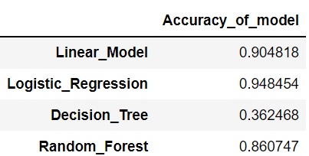
Descriptive Analysis
Models Accuracy
This slide show the Accuracy of all the models contain in our capstone project

Slide 15
Descriptive Analysis
Conclusion
All in all, in this project, we found females drink more alcohol as compared to male students. we have dataset about two schools student’s and after analysis it give us GP school learners, consume large amount of alcohol rather than other school. Additionally this dataset is all about the consumption of alcohol along with the factors effecting the grades of student’s. In the next step, we found the correlation and after finding the correlation we found that G2 and G3 are strongly positively correlated. Then, we performed four models in our project and got the accuracy of every model. In all the models all the target variable is same which is G3 and independent variables are G1, G2 and absences. According to our dataset, logistic regression give more accuracy. It means this model (Logistic regression) is suitable for our project.
References:
https://www.kaggle.com/uciml/student-alcohol-consumption
https://github.com/KomalAroraKA/Capstone-Project-Student-Alcohol-Consumption-/upload

